Slide 1
Understanding Widgets

Slide 2
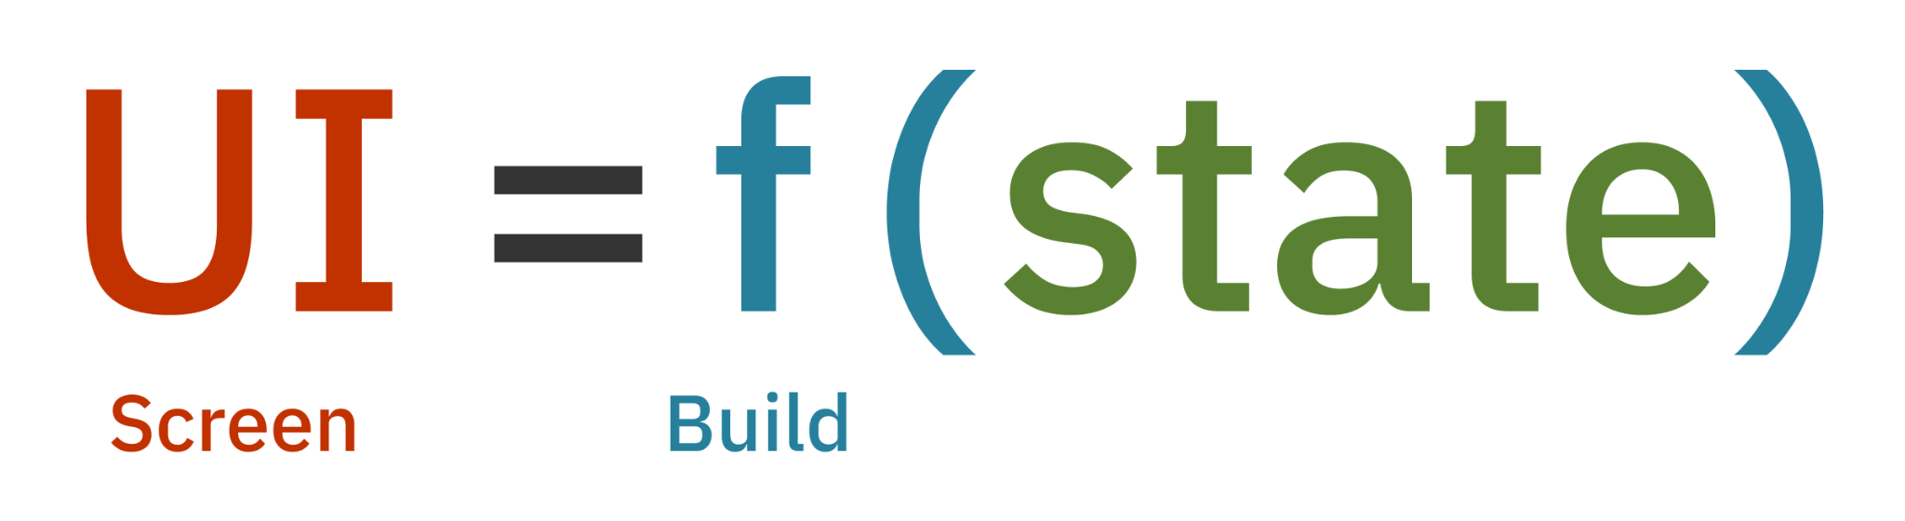
Widget
A widget is a building block for your user interface
A widget declares its user interface by overriding the build() method, which is a function that converts state to UI:

Slide 3
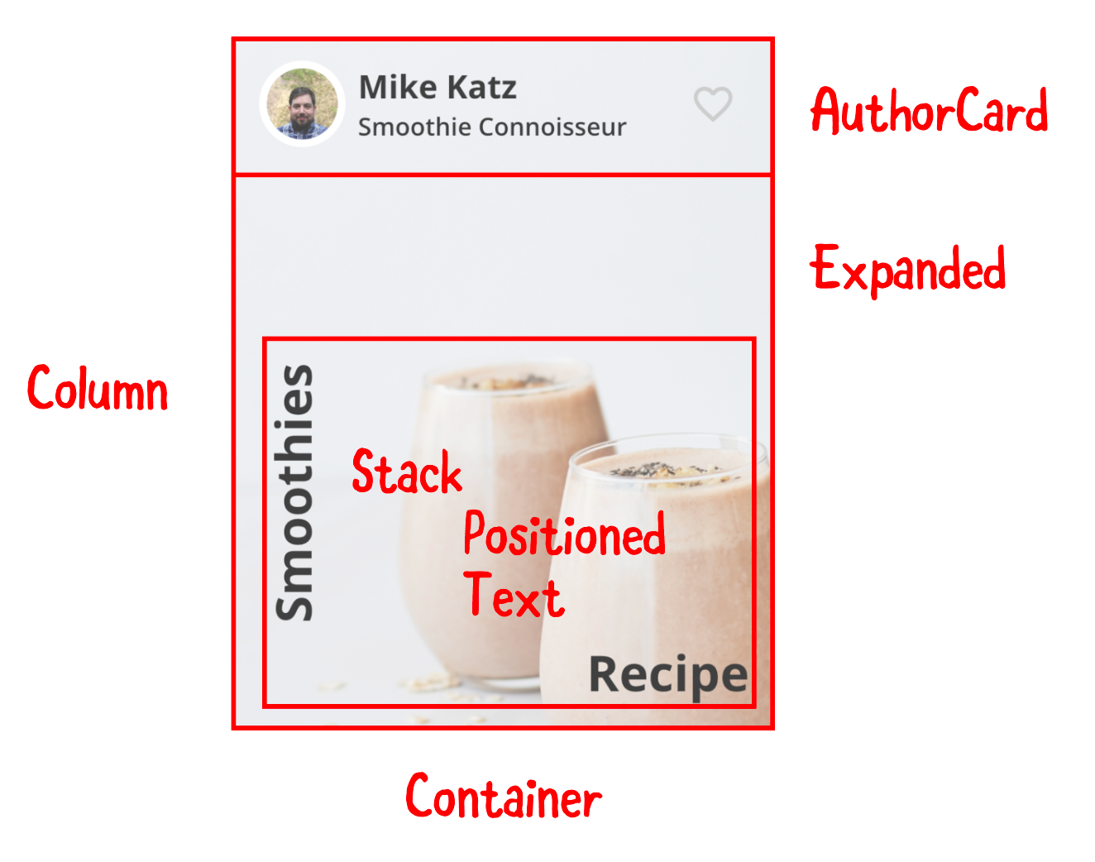
Example Widget

Slide 4
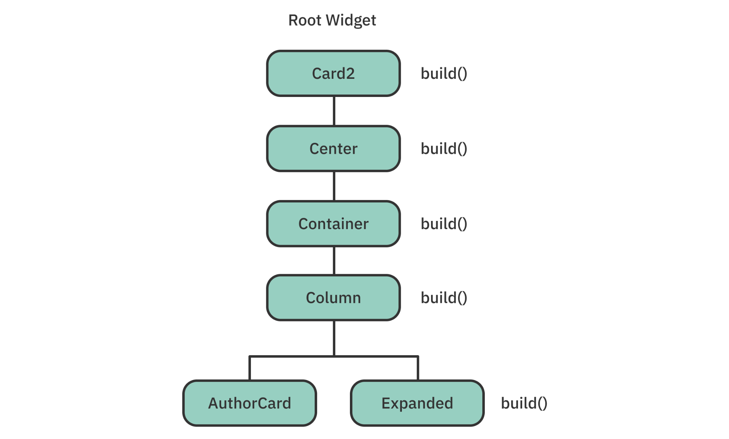
Widget Tree

Slide 5
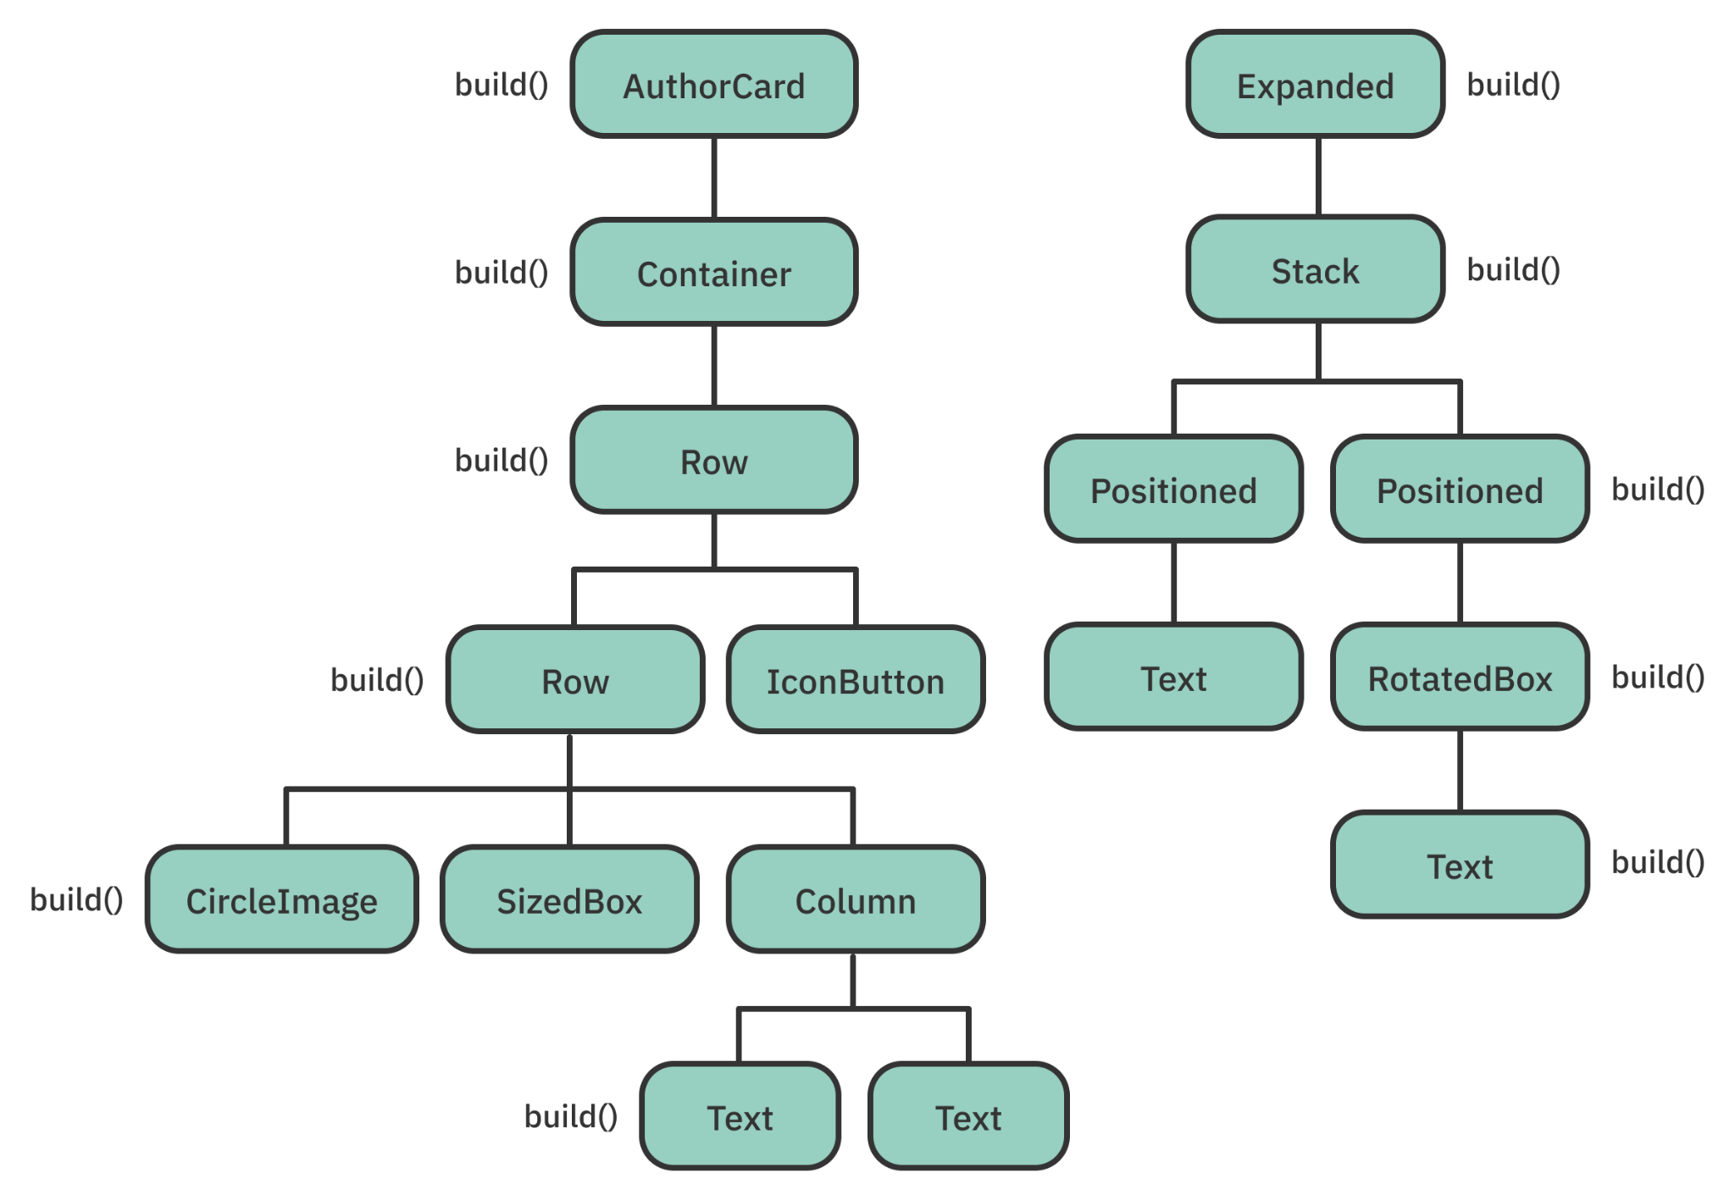
Widget Tree

Slide 6
Types of Widgets
There are three major types of widgets:
Stateless, Stateful and Inherited
All widgets are immutable but some have state attached to them using their element

Slide 7
Stateless widgets
You can’t alter the state or properties of Stateless widget once it’s built
When your properties don’t need to change over time, it’s generally a good idea to start with a stateless widget

Slide 8
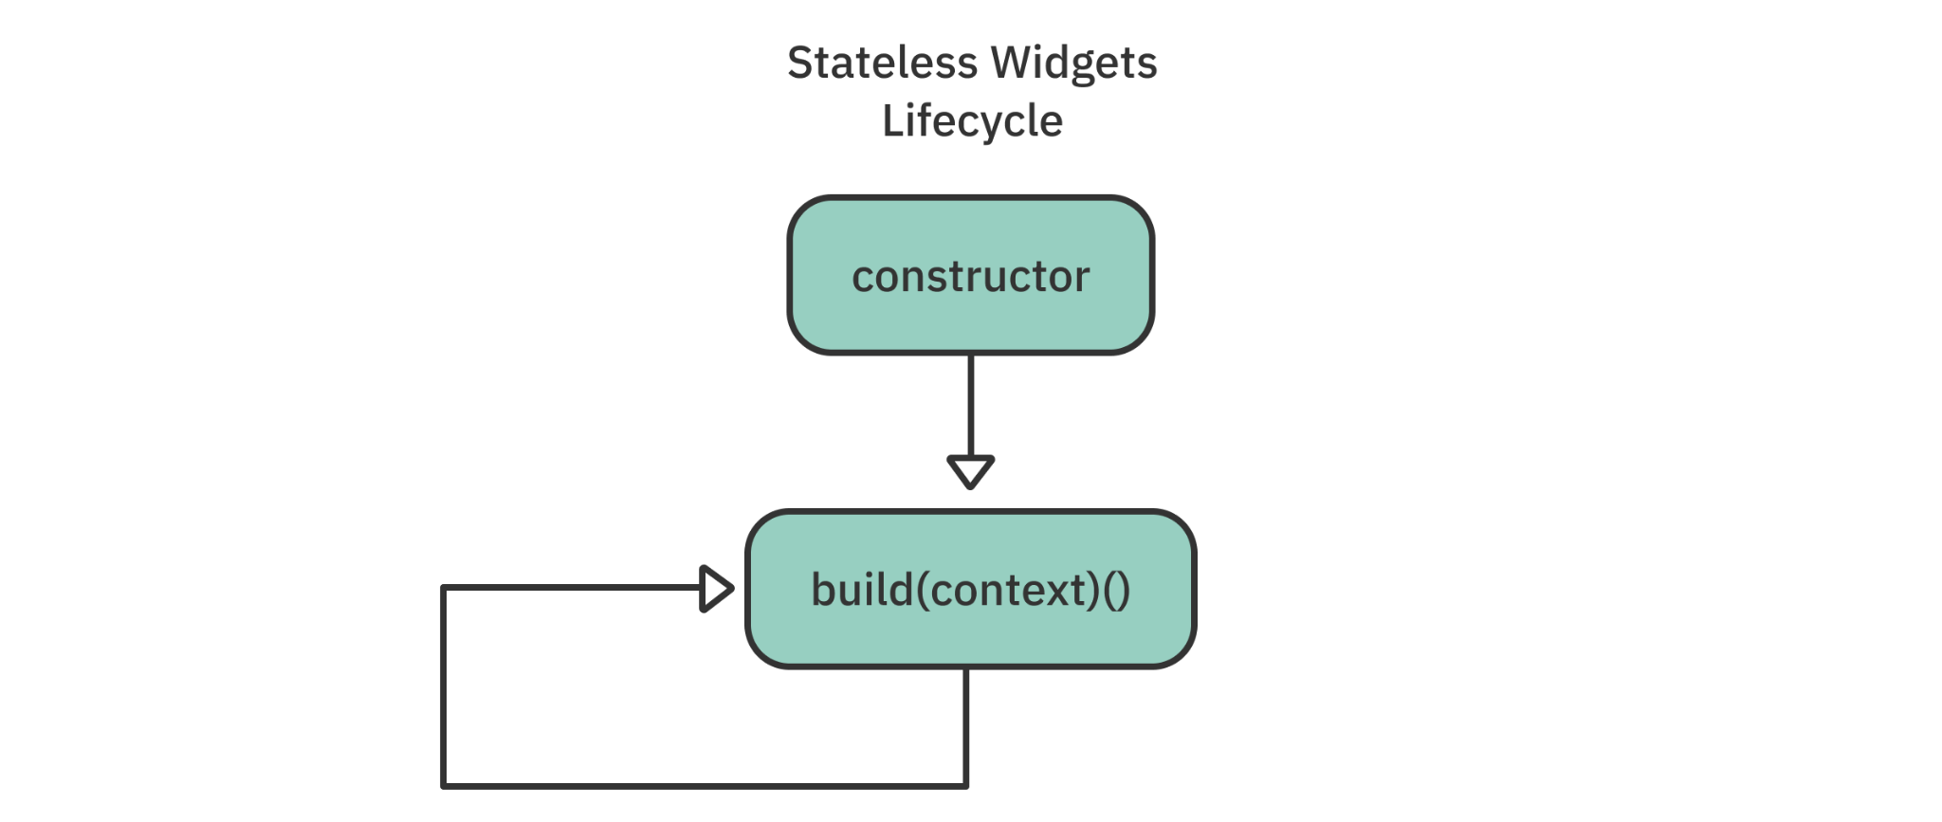
Stateless widgets

Slide 9
Stateless widgets
The lifecycle of a stateless widget starts with a constructor, which you can pass parameters to, and a build() method, which you override
The visual description of the widget is determined by the build() method

Slide 10
Stateless widgets
The following events trigger stateless widgets to update:
The widget is inserted into the widget tree for the first time
The state of a dependency or inherited widget — ancestor nodes — changes

Slide 11
Stateful widgets
Stateful widgets preserve state, which is useful when parts of your UI need to change dynamically
For example,
one good time to use a stateful widget is when a user taps a Favorite button to toggle a simple Boolean value on and off

Slide 12
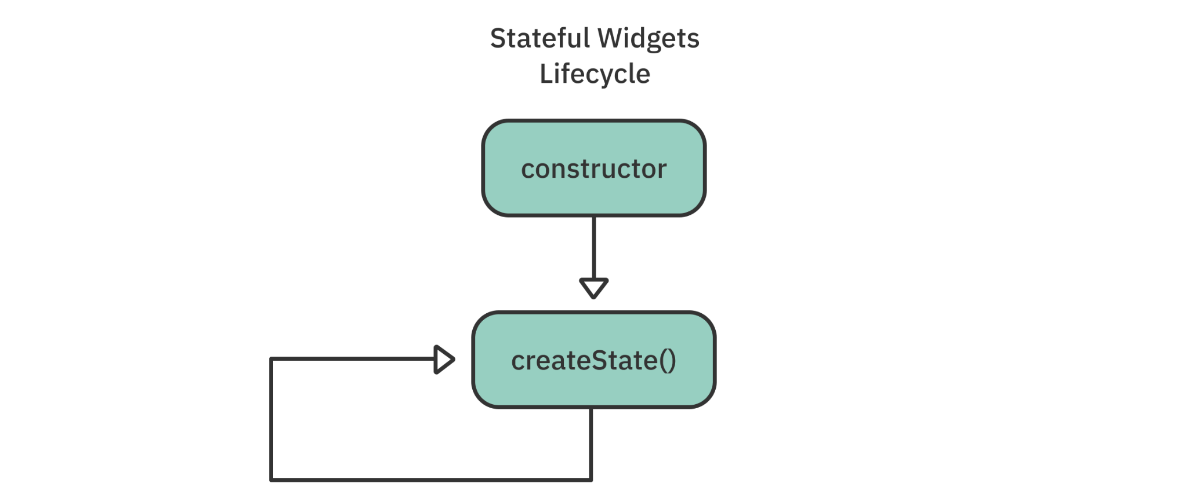
Stateful widgets

Slide 13
Stateful widgets
Stateful widgets store their mutable state in a separate State class
That’s why every stateful widget must override and implement createState()
class MyWidget extends StatefulWidget {
// ...
@override
State<MyWidget> createState() => _MyWidgetState();
}

Slide 14
State object lifecycle
Every widget’s build() method takes a BuildContext as an argument
The build context tells you where you are in the tree of widgets
You can access the element for any widget through the BuildContext

Slide 15
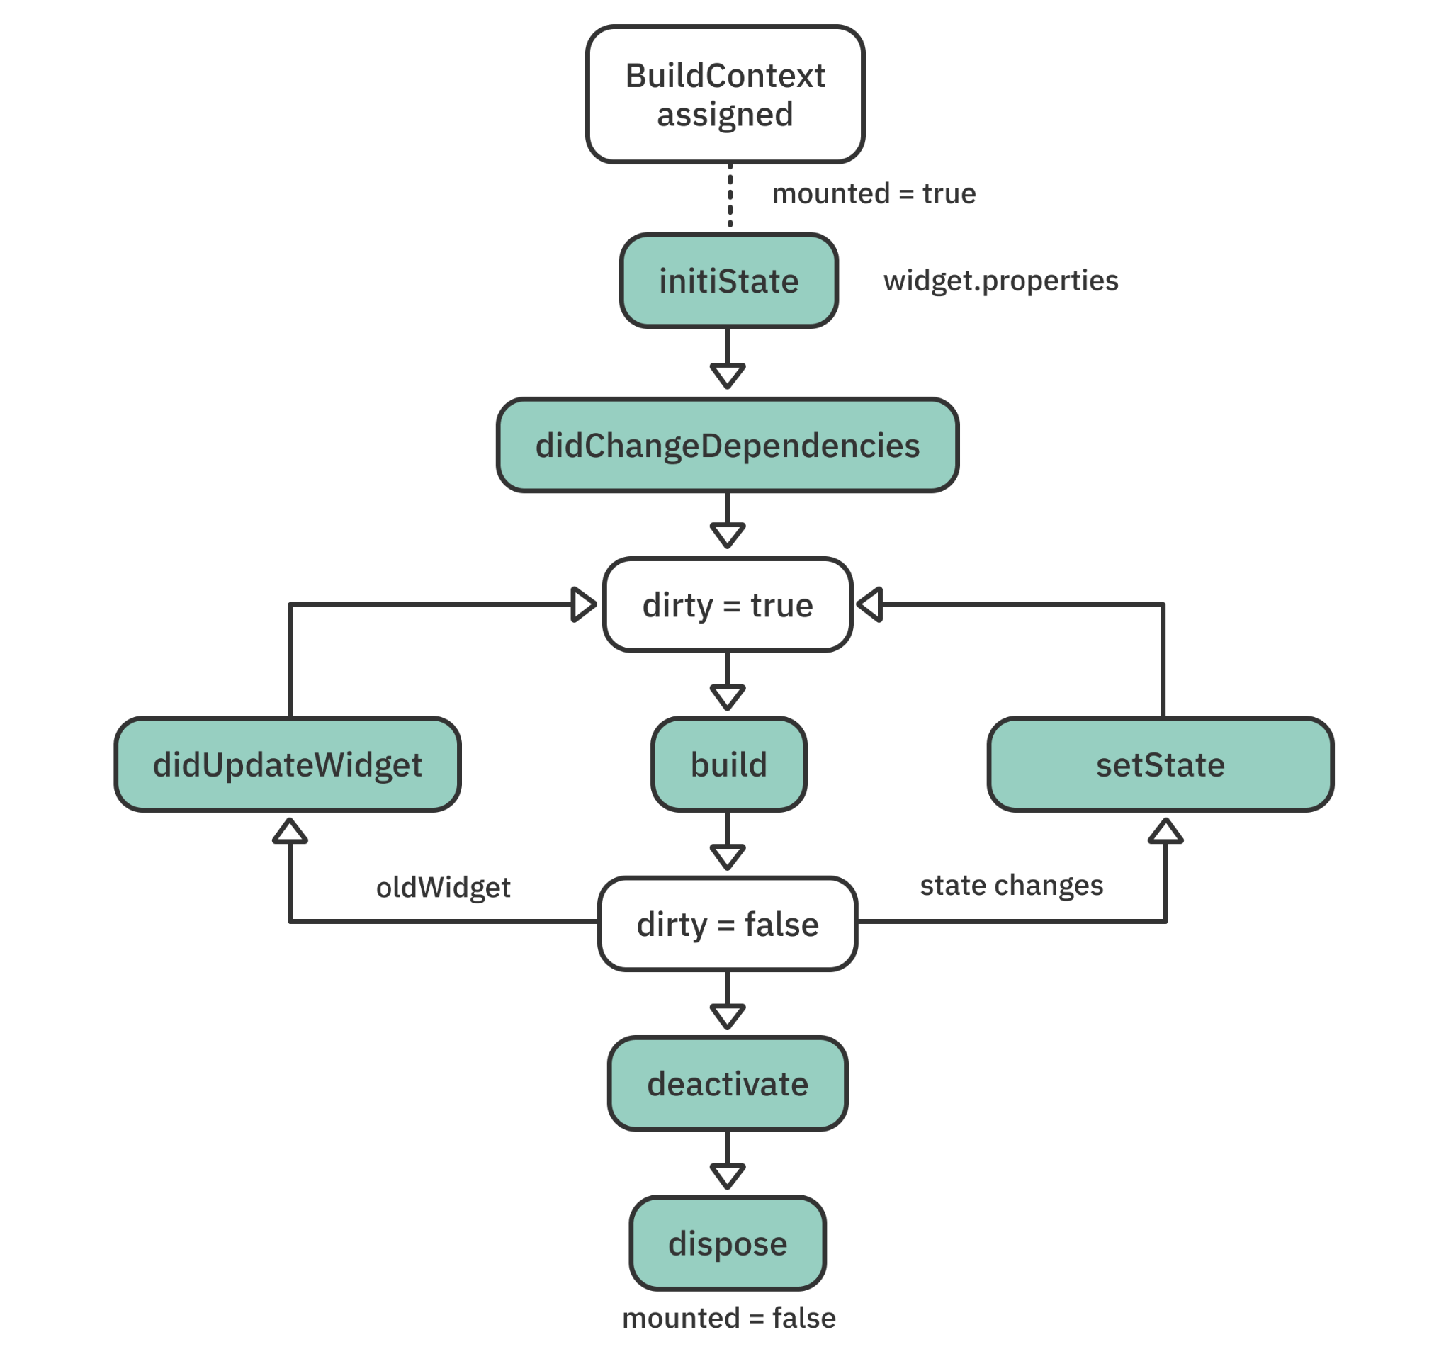
State object lifecycle

Slide 16
When you assign the build context to a widget, mounted is set to true
It lets the framework know that this widget is currently on the widget tree

Slide 17
initState() is the first method called after a widget is created

Slide 18
didChangeDependencies() is called the first time the framework builds a widget
The framework might call didChangeDependencies() again if your state object depends on an inherited widget that has changed

Slide 19
This function is the most important for developers because it’s called every time a widget needs rendering

Slide 20
The framework calls didUpdateWidget(_) when a parent widget makes a change or needs to redraw the UI

Slide 21
Whenever you want to modify the state in your widget, you call setState()
The framework then marks the widget as dirty and triggers a build() again

Slide 22
When you remove the object from the tree, the framework calls deactivate()

Slide 23
The framework calls dispose() when you permanently remove the object and its state from the tree

Slide 24
Example

Slide 25
class AuthorCard extends StatefulWidget {
// ...
@override
State<AuthorCard> createState() => _AuthorCardState();
}
class _AuthorCardState extends State<AuthorCard> {
// ...
@override
Widget build(BuildContext context) {
// ...
}
}

Slide 26
Inside _AuthorCardState class
// ...
bool _isFavorited = false;
// ...
IconButton(
icon: Icon(_isFavorited ? Icons.favorite : Icons.favorite_border),
iconSize: 30,
color: Colors.red[400],
onPressed: () {
setState(() {
isFavorited = !_isFavorited;
});
},
)
// ...

Slide 27
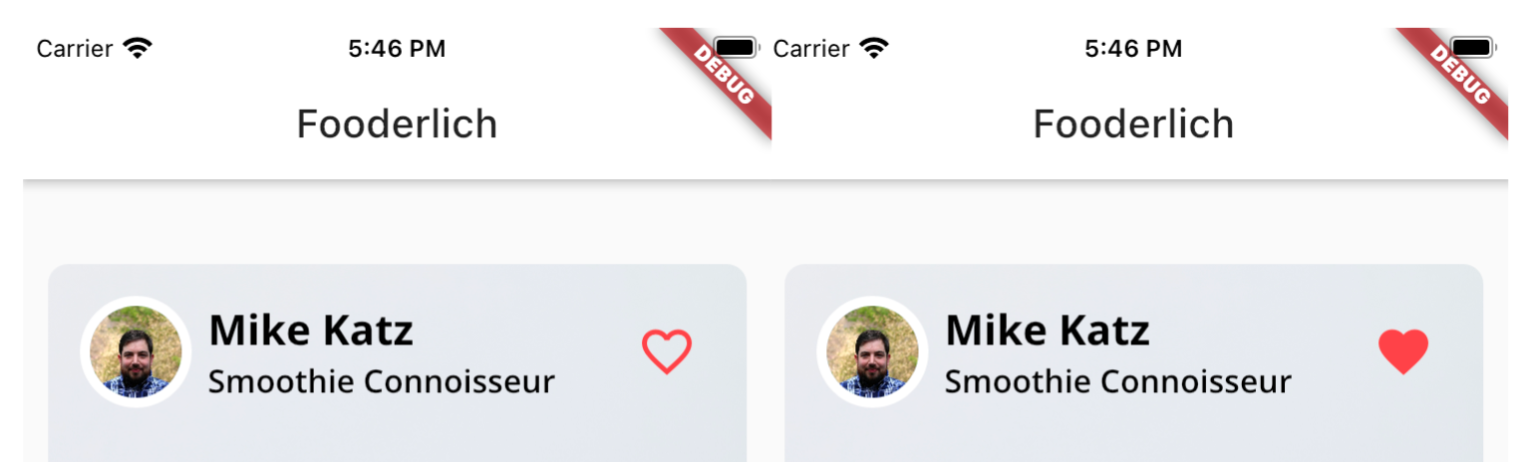
Examining the widget tree

Slide 28
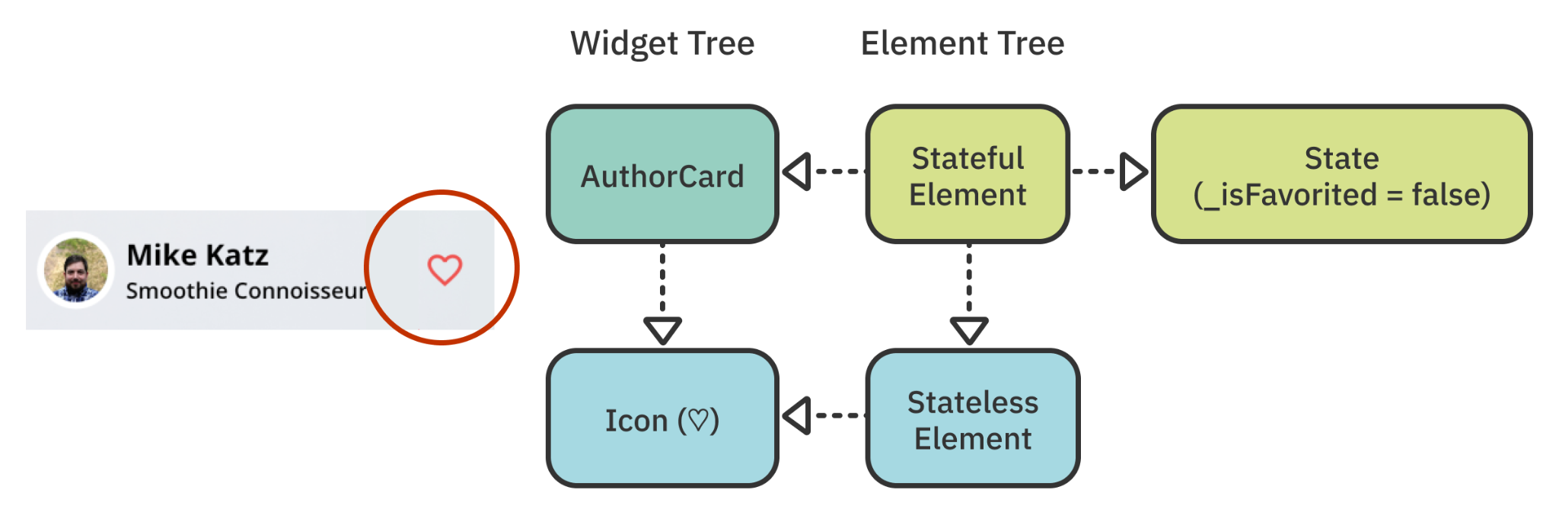
Examining the widget tree
The StatefulElement manages the State object

Slide 29
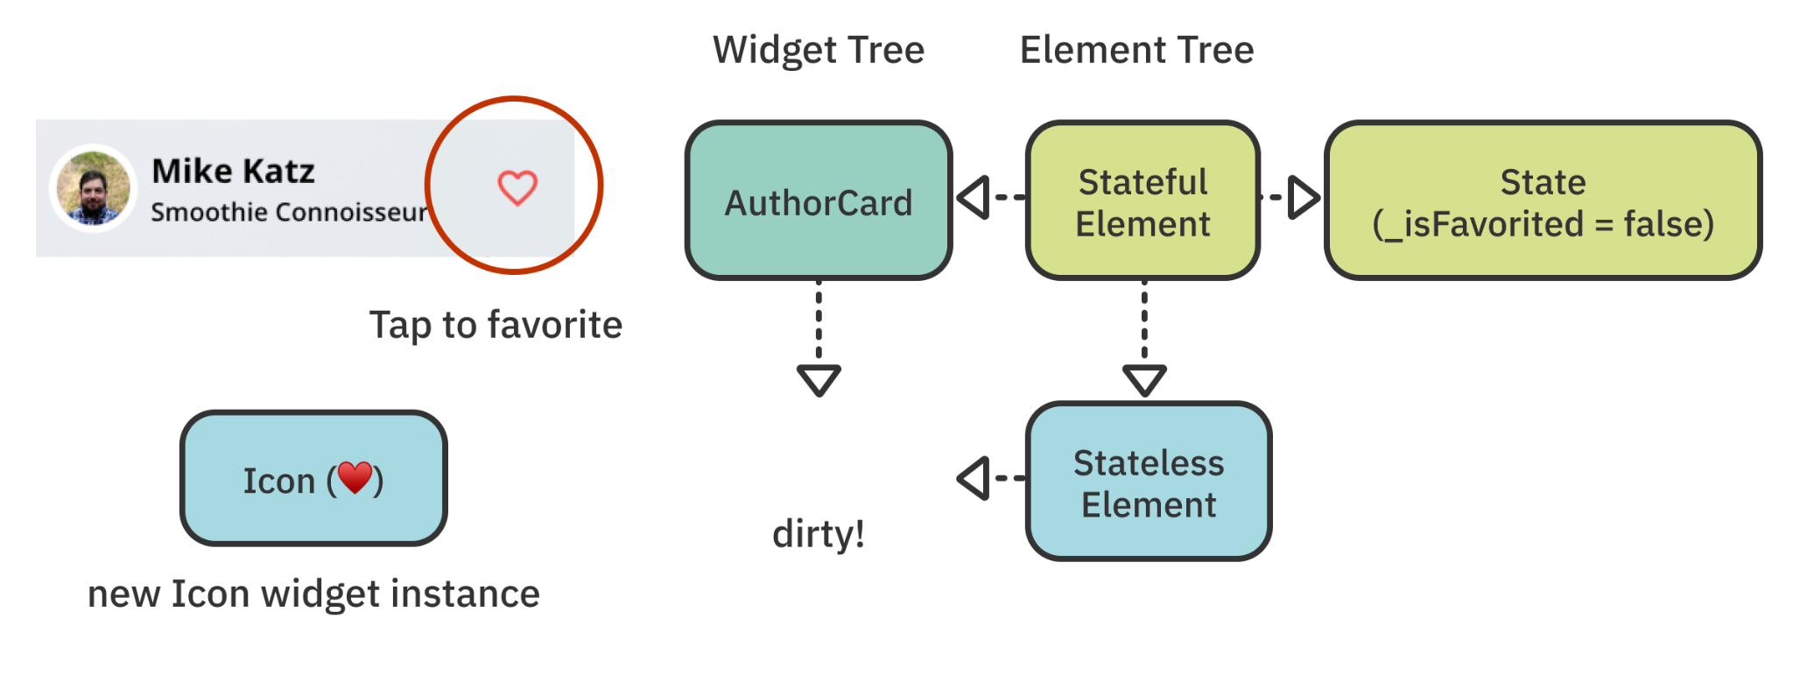
Examining the widget tree
true
When the user taps the heart button, setState() runs and toggles _isFavorited to true Internally, the state object marks this element as dirty

Slide 30
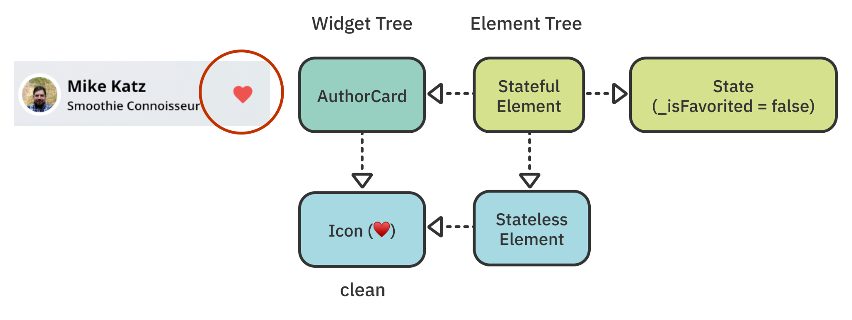
Examining the widget tree
true
Rather than reconstructing the whole tree, the framework only updates the widgets that need to be changed

